Slide 1

Best Stationery Shop
Location
Project by:
PRASFUR TIWARI

Slide 2
Introduction
India’s population is around 1.38 billion and is a hub of nearly 315 students.
There are 15 lakh schools in India and is one of the biggest education systems in the world.
Every student needs education, and hence, nearly all of them attend schools.

Slide 3
Business Problem
With the increase in number of students, the number of schools will ultimately rise.
Every student is allotted with some homework or project work which requires a lot of stationery stuff.
This generates a need for a stationery shop to aid the students with their educational work.

Slide 4
Solution
The solution is to set up a stationery shop in a region where many schools are located.
This problem can be solved using Data Science.
The locations of schools can be gathered and clustered in different groups so as to get a suitable location for the shop.

Slide 5
Data Gathering/Collection
Using the website Foursquare, the data was gathered by generating a search query on Jupyter notebook with Python kernel.
The necessary foursquare credentials, i.e. the client id and client secret were passed in the query.
To be specific, we aim to find the schools in Kanpur city, Uttar Pradesh.

Slide 6
Data Preprocessing and Wrangling
Using the pandas module of python, only useful and relevant data required for the analysis was filtered.
We extract on the ‘venues’ data under the ‘response’ section.
This dataset still contains irrelevant data and needs to be filtered and cleaned.

Slide 7
Data Filtering
The ‘category’ column had a set of values like ‘id’, ‘name’ etc. and some of them were actually redundant for our dataset.
Hence, only the ‘name’ of the ‘category’ was filtered, which gave some detail of the location.
This make data more a bit more readable.

Slide 8
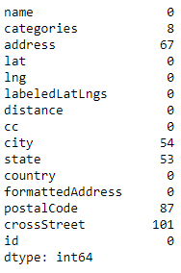
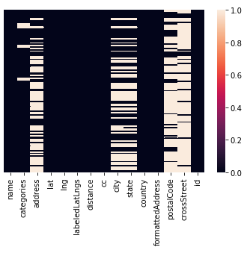
Data Cleaning
Null, none and NaN values are detected and irrelevant columns are removed.
The columns are removed keeping the fact in mind that necessary data isn’t removed.

Slide 9
Data Standardization
The scikit-learn module is used so as to standardize the data.
An array of standard values is returned by the scikit-learn module.
The data is standardized to get a suitable range of data for model fitting.

Slide 10
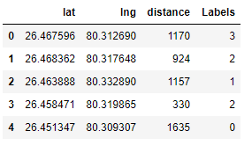
Model Fitting
The k-means algorithm is selected to perform clustering.
The value of ‘k’ is selected as 4 for this project.
The model is fitted using the scikit-learn module and labels for each data values are generated, ranging from 0 to 3.

Slide 11
Color Coding
To view the clusters separately and help visualization, each label was assigned with a color code.
The color codes used in this project are:
Label | Color Code
1 | Red
2 | Yellow
3 | Blue
4 | Green

Slide 12
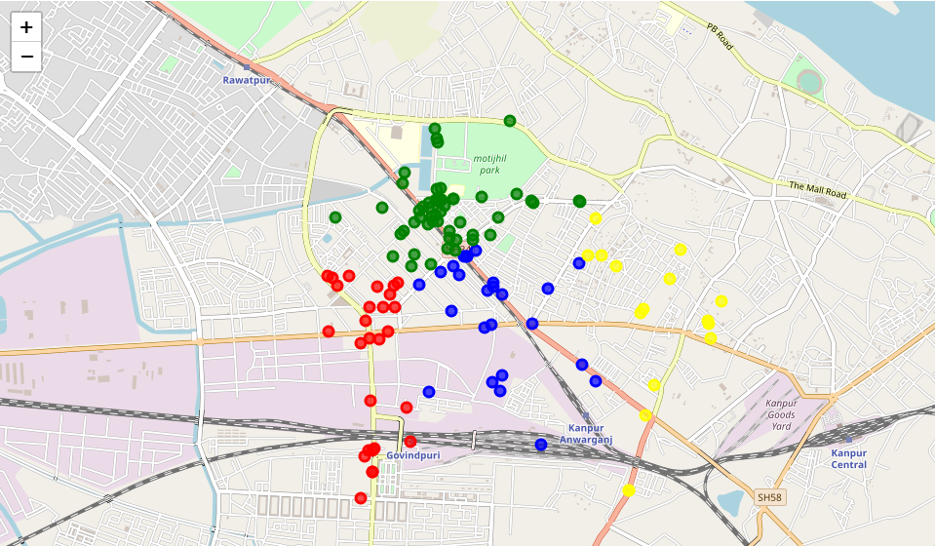
Data Visualization
The clusters, based on their color codes, are visualized on a world map centered on Kanpur.

Slide 13
Finding Count
The number of schools in each cluster is noted so as to find the best suited cluster or location for the stationery shop.
It comes out to be:
Cluster | Schools
1 | 27
2 | 16
3 | 25
4 | 51

Slide 14
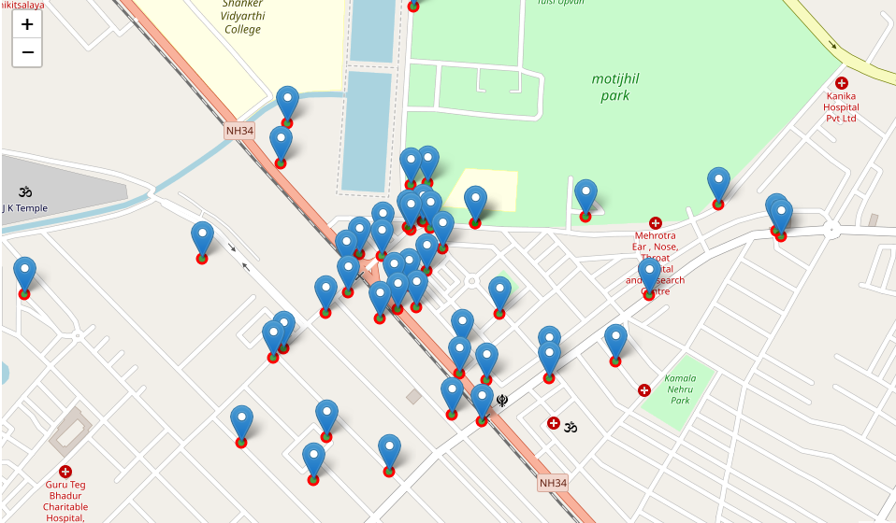
Visualizing Target Cluster
Since the 4th cluster has the most number of schools, it qualifies to be the best location for the shop.
Visualizing 4th cluster with pop-ups to get a better idea of the area:

Slide 15
Observation
It was noted that the 4th cluster had 51 schools. It’s logical to assume that more and more schools will attract more students. Hence, the areas inside the 4th cluster qualify to become the best suited place for a stationery shop business.
Project URL:
https://nbviewer.jupyter.org/github/Prasfur/Coursera_Capstone/blob/master/Applied%20Data%20Science%20Capstone.ipynb

